Slide 1
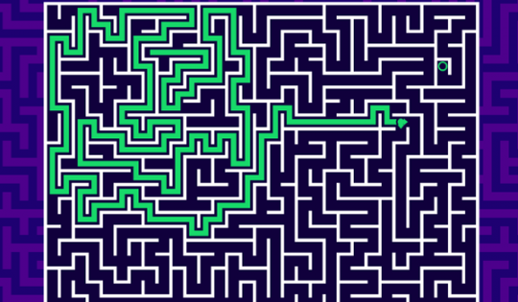
Shortest Path In Maze
Umut Talha Çalışkan, 20052097
Ecem Özselgin, 20052054
Muhammed Yusuf Demir, 21052067
Yasira İlyas, 17058903
Mükrime Nur Gümüş, 21052083
Furkan Mete Erol, 19052620

Slide 2
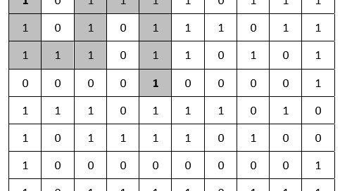
Introduction Manhattan Heuristic Breadth-first A*

Slide 3

PEAS for shortest path in maze

Slide 4

Performance measure: Finding the shortest path from the starting point to the goal point in the maze.

Slide 5
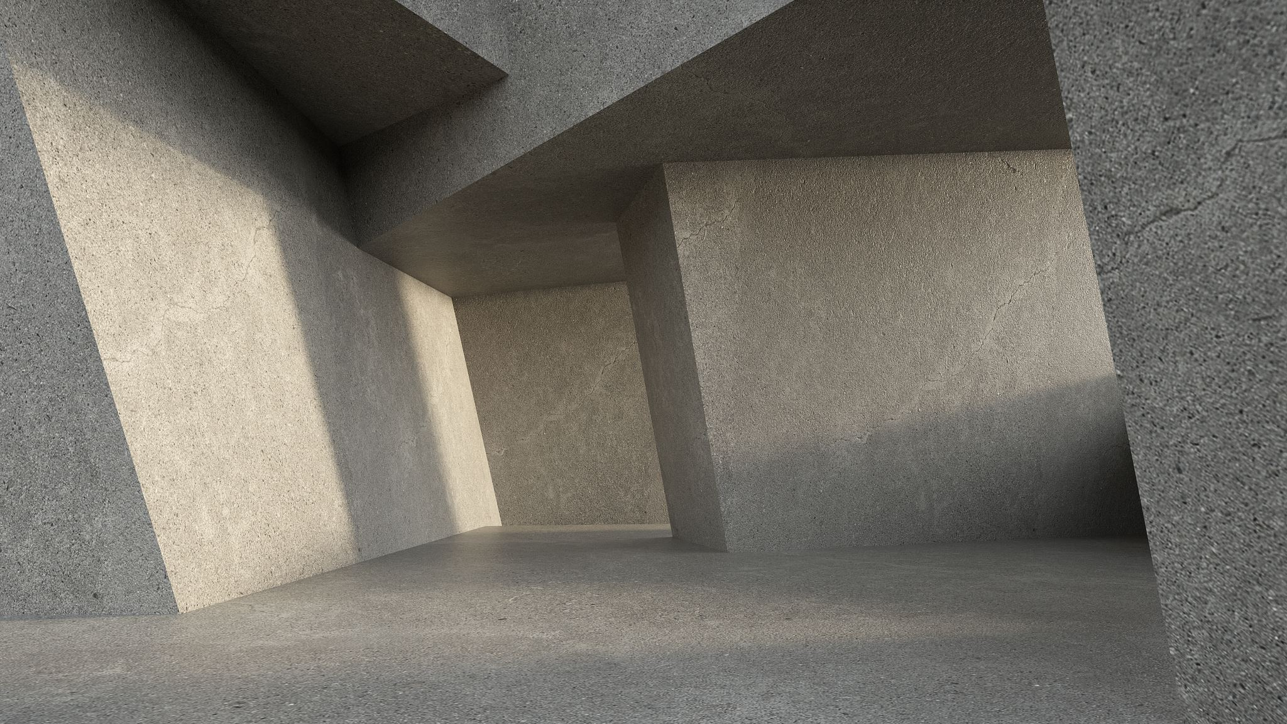
Environment: Walls, paths, a starting point, and a goal point.

Slide 6

Actuators: The actuators would be the movements that the agent can make to navigate through the maze, such as moving up, down, left, or right.

Slide 7

Sensors: The sensors would be the inputs that the agent receives from the environment, such as information about the walls and paths in the maze, the location of the starting point, and the location of the goal point. The agent would also receive feedback on its current location and whether it has reached the goal point

Slide 8
The nature of the environment
Fully observable
Deterministic
Single agent
Static
Discrete

Slide 9

Our agent is Goal Based

